Slide 1

Online voting system

Slide 2
Background
Election or voting is a formal process by which Voters make their political choice on public office or candidates for public office. It makes a fundamental contribution to democratic governance.
The Constitution of the Federal Democratic Republic of Ethiopia, in its article 56, declares a Political Party or a Coalition of Political Parties that has the greatest number of seats in the House of People's Representatives shall form the executive and lead it.
Also in the Amended Electoral Law of Ethiopia, Proclamation no 532/2007, clearly puts that a Candidate who received more votes than other Candidates within a Constituency shall be declared the winner (Article 25).

Slide 3
Statement of the problem
In Ethiopia, elections take place every five years to elect members of HOR. The electoral procedure involves many processes. The processes are voter Registration, Voter Register Exhibition, Voting, Vote Counting, Collation and Publication of Results.
A number of problems associated with each phase of the electoral process are :
- Invalid votes: be invalid if the thumbprint or the mark has not been placed at the right spot
-Long voting process
-Delays in result publication
-High cost of election organizing

Slide 4
Objective of the project
General objective
- The main objective of the project is producing a web based voting system that can
supplement the current paper based voting system of Ethiopia.
Specific objective
- Identifying the problem
- Selecting the appropriate development tools for the system
- Designing friendly user interface
- Designing database to the system that can hold all the
information
- Implementing standard security algorithms that can keep the
confidentiality of the data
- Testing the system
- Integrating the whole system

Slide 5
Scope of the project
The scope of this project is developing web based voting system for Ethiopia.There are different kinds of electronic voting system in the world, but this project targets to do web based voting system. The system contains modules that can handle voters’ and candidates’ registration system, including vote counting module. The project will cover the following activities:-
- Cast vote online.
- Registering voter and candidate to database.
- Create account to the system users.
- Generate report from the database.
- Manipulate (or edit) profile and change password.
- View profile from the database.
- Show vote result online.
- Limit access level of the voter.
- Encrypt user data

Slide 6
Significance of the project
The proposed system has the following main purposes:
- Improve voting service to the voters through fast, timely and
convenient voting.
- Reduction of the cost incurred by the election board during
voting process
- reduce the number of the staffs during the election
- cost cutting to produce an effective election management system.
- The system is a lot easier to independently moderate the
elections and subsequently reinforce its transparency and fairness.

Slide 7
Methodology and Tools used
Fact finding techniques
- Interview
- Document(literature review)
- By discussing and analyzing
Tools used
software
- Visio software - Microsoft word 2013
- Rational Rose - Edrow max
- Microsoft PowerPoint 2013 - Xamp server
- Mysql database server - Visio 2013
- Notepad++
Hardware
- Any Desktop Computer
- Flash disk 2GB - 8GB
- Compactable CD-ROM 700MB
- Laptop

Slide 8
Proposed Systems
The main aim of this project is to automate the current manual system and it will solve the problems that are in the manual system. This system saves resources by doing all things used in election system; and counts the result for each candidate correctly and report with exact value electronically.
The new system does not pass over without reporting the occurred errors during the counting result. Also in security side our system is secured because, it needs User name and Password. Before the Election Day the system will be used for viewing candidates’ profiles. Our system will be in election mode, for the purpose of vote casting only on the Election Day.

Slide 9
Cont’d…
When aiming this system we consider the following significance aspects:
- Reduce the time and task required to perform the operation
within the election area.
- It will change the manual processing to computerize system.
-It will provide speed, efficient, Flexibility, reliability, and security
for the system users.
-For voters, better satisfaction of the speed provided by the
system casting their vote.
-And it improved the moral (motivation) of the users to use the new
technology.

Slide 10
Functional and Nonfunctional requirement
Functional
- Register Election Officer, Election Registrar, Candidates
and voter
- Check authorization to cast a vote
- Cast Vote
- Generate report
- Counting
- Authentication
Nonfunctional
- Usability Requirements
- Reliability Requirements
- Performance Requirements
- Security Requirements
- Safety Requirements

Slide 11
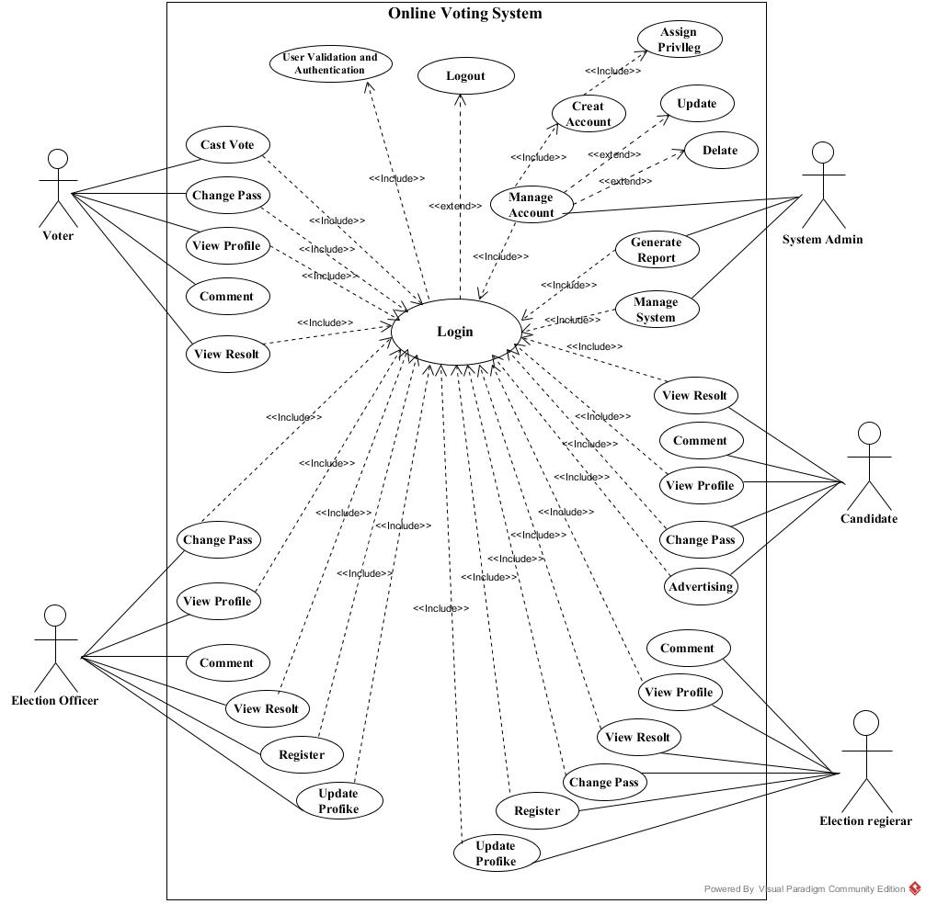

Slide 12
Sequence diagram A Sequence diagram is an interaction diagram that shows how processes operate with one another and in what order.
Login sequence diagram

Slide 13
Sequence diagram to cast a vote by voter

Slide 14
Activity diagram for
Activity diagram is another important diagram in UML to describe dynamic aspects of the system. Activity diagram is basically a flow chart to represent the flow form one activity to another activity.
Activity diagram of system admin:
Activity diagram for view result:

Slide 15
Analysis class diagram
Class diagrams show the static structure of the model, in particular, the things that exist.

Slide 16
Collaboration diagram
describes interactions among objects in terms of sequenced messages.
Collaboration diagram for login: Collaboration diagram for cast vote:

Slide 17
Design goals
The goal of the system design is to manage complexity by dividing the system in to manageable pieces.
- Modifiability
- Flexibility
- Efficiency
- Accessibility :
- without geographical location limitation
- accessible without time limitation
- or the same information accessed by multiple users at the same time.

Slide 18
System architecture
The architecture chosen for the system is three tier. The first layer runs on the client side, the second layer at the middle layer and the third layer will be the database system.

Slide 19
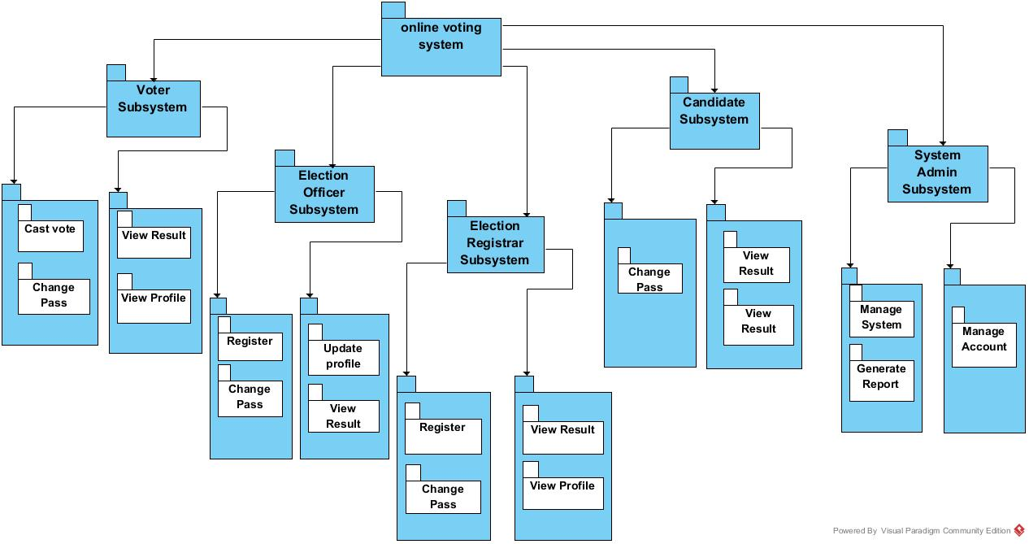
System decomposition
System decomposition refers to the process by which a complex problem or system is broken down into parts that are easier to conceive, understand, program, and maintain.

Slide 20
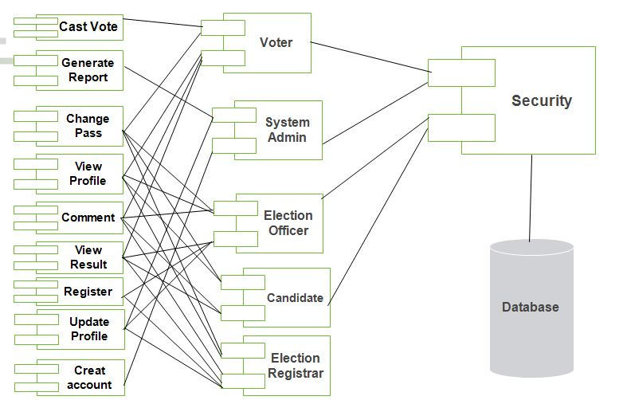
Component modeling
shows which component or objects will be accessed by whom

Slide 21
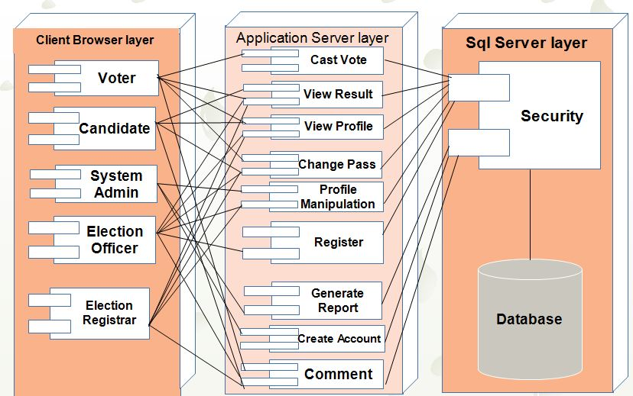
Deployment Diagram
used to show the hardware of the system, the software that is installed in the hardware and also the middleware that is used to connect the dissimilar machines to one and other. It also shows how the software and the hardware components work together.

Slide 22
User interface prototyping
A user-interface prototype is a prototype of the user interface.

Slide 23
Design class diagram
It shows the static features of the actors and do not represent any particular processing. It is an abstraction of the real environment class of, user and Administrator.

Slide 24
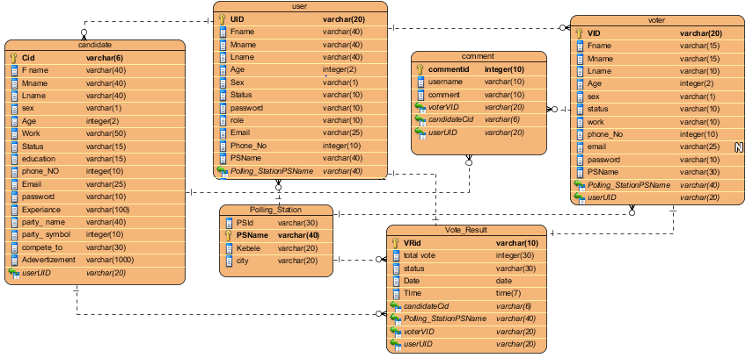
Database design
This logical data model contains all the needed logical and physical design choices and physical storage parameters needed to generate a design in a Data Definition Language.

Slide 25


